Slide 1

Programming Languages 11300 Lecture 3
Functions

Slide 2
What is a function?

Slide 3
Functions
From Mathematics we know that functions perform some operation and return one value.
They "encapsulate" the performance of some particular operation, so it can be used by others (for example, the sqrt() function)

Slide 4
Why have them?
Support divide-and-conquer strategy
Abstraction of an operation
Reuse. Once written, use again
Sharing. If tested, others can use
Simplify code. More readable.

Slide 5
Mathematical Notation
Consider a function which converts temperatures in Celsius to temperatures in Fahrenheit.
Formula: F = C * 1.8 + 32.0
Functional notation:
F = celsius_to_Fahrenheit(C) where
celsius_to_Fahrenheit(C) = C * 1.8 + 32.0

Slide 6
Python Invocation
Math: F = celsius_to_Fahrenheit(C)
Python, the invocation is much the same
F = celsius_to_Fahrenheit(cel_float)
Terminology: cel_float is the argument

Slide 7
Function defintion
Math: g(C) = C*1.8 + 32.0
Python:
def celsius_to_Fahrenheit(param_float):
return param_float * 1.8 + 32.0
Terminology: param_float is the parameter

Slide 8
Argument vs Parameter What is the difference?

Slide 9
Figure 5.1 Function Parts

Slide 10
return statement
The return statement indicates the value that is returned by the function
This statement is optional (the function can return nothing). If no return, function is often called a procedure.

Slide 11
Code Listing 5.1
Temp convert

Slide 13
Triple quoted string in function
A triple quoted string just after the def is called a docstring
docstring is documentation of the function's purpose, to be used by other tools to tell the user what the function is used for.

Slide 14
Operation
1. Call copies argument C to parameter Temp
F = celsius_to_fahrenheit(C)
2. Control transfers to function
def celsius_to_Fahrenheit (param):
return param * 1.8 + 32.0

Slide 15
Operation (con't)
F = celsius_to_fahrenheit(C)
3. Expression in function is evaluated
4. Value of expression is returned to the invoker
def celsius_to_Fahrenheit (param):
return param * 1.8 + 32.0

Slide 16
Figure 5.1 Function flow of control

Slide 17
Code Listing 5.2
Full Temp Program

Slide 19
Code Listing 5.3
digit extraction

Slide 20
Another Example.
Let’s write a function to extract the digit from a number. Let’s think about it for a while.
Any ideas?

Slide 21
Area of a Triangle
The next few functions can be used together to find the area of a triangle.
Note how we decompose the problem and then re-assemble the overall solution using the functions created

Slide 22
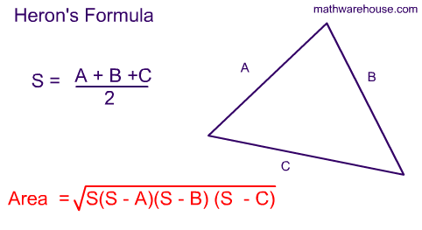

Slide 23
Code Listing 5.4
Input of sides

Slide 24
def get_vertex():
x = float(input(" Please enter x: "))
y = float(input(" Please enter y: "))
return x,y

Slide 25
Code Listing 5.5
get_triangle

Slide 26
def get_triangle():
print("First vertex")
x1,y1 = get_vertex()
print("Second vertex")
x2,y2 = get_vertex()
print("Third vertex")
x3,y3 = get_vertex()
return x1, y1, x2, y2, x3, y3

Slide 27
Code Listing 5.6
side_length

Slide 28
def side_length(x1,y1,x2,y2):
''' return length of a side (Euclidean distance) '''
return math.sqrt((x1-x2)**2 + (y1-y2)**2)

Slide 29
Code Listing 5.7
calculate_area

Slide 30
def calculate_area(x1,y1,x2,y2,x3,y3):
''' return area using Heron's formula '''
a = side_length(x1,y1,x2,y2)
b = side_length(x2,y2,x3,y3)
c = side_length(x3,y3,x1,y1)
s = (1/2)*(a + b + c)
return math.sqrt(s*(s-a)*(s-b)*(s-c))

Slide 31
Code Listing 5.8
Full Triangle Program

Slide 32
import math
def get_vertex():
x = float(input(" Please enter x: "))
y = float(input(" Please enter y: "))
return x,y
def get_triangle():
print("First vertex")
x1,y1 = get_vertex()
print("Second vertex")
x2,y2 = get_vertex()
print("Third vertex")
x3,y3 = get_vertex()
return x1, y1, x2, y2, x3, y3
def side_length(x1,y1,x2,y2):
'''return length of a side (Euclidean distance)'''
return math.sqrt((x1-x2)**2 + (y1-y2)**2)
def calculate_area(x1,y1,x2,y2,x3,y3):
'''return area using Heron's forumula'''
a = side_length(x1,y1,x2,y2)
b = side_length(x2,y2,x3,y3)
c = side_length(x3,y3,x1,y1)
s = (1/2)*(a + b + c)
return math.sqrt(s*(s-a)*(s-b)*(s-c))
x1, y1, x2, y2, x3, y3 = get_triangle()
area = calculate_area(x1,y1,x2,y2,x3,y3)
print("Area is",area)

Slide 33
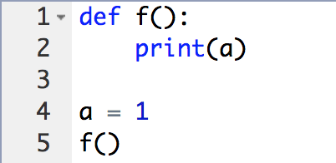
Function Variables
What is the output of the following function?
Hint: Inside the function, you can use variables declared somewhere outside of it:

Slide 34
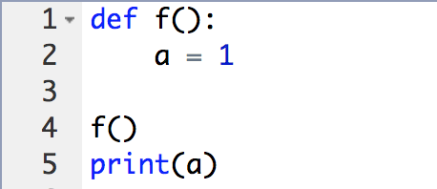
Function Variables
What is the output of the following function?

Slide 35
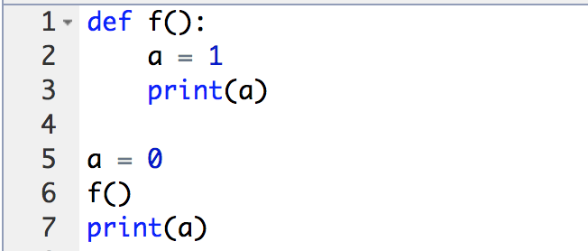
Function Variables
We can change the value of a global variable inside a function, let’s try this:

Slide 36
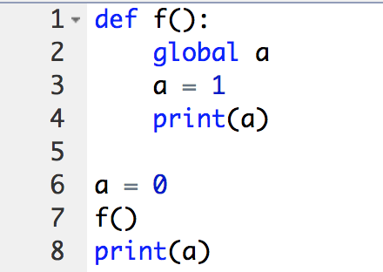
Function Variables
Using global keyword:

Slide 37
Lambda Functions
What is a Lambda Function?
LISP anyone?

Slide 38
Lambda Functions
The lambda operator or lambda function is a way to create small anonymous functions,
i.e. functions without a name.
These functions are throw-away functions, i.e. they are just needed where they have been created.
Lambda functions are mainly used in combination with the functions filter(), map() and reduce().

Slide 39
Lambda Functions
The general syntax of a lambda function is quite simple:
lambda argument_list: expression

Slide 40
Lambda Functions
The following example of a lambda function returns the sum of its two arguments:
>>> sum = lambda x, y : x + y
>>> sum(3,4)
7
>>>

Slide 41
Did functions help?
Made our problem solving easier (solved smaller problems as functions)
main program very readable (details hid in the functions)

Slide 42
How to write a function
Does one thing. If it does too many things, it should be broken down into multiple functions (refactored)
Readable. How often should we say this? If you write it, it should be readable
Reusable. If it does one thing well, then when a similar situation (in another program) occurs, use it there as well.

Slide 43
More on functions
Complete. A function should check for all the cases where it might be invoked. Check for potential errors.
Not too long. Kind of synonymous with do one thing. Use it as a measure of doing too much.

Slide 44
Important Rule
A function should do one thing!!!

Slide 45
Procedures
Functions that have no return statements are often called procedures.
Procedures are used to perform some duty (print output, store a file, etc.)
Remember, return is not required.

Slide 46
Multiple returns in a function
A function can have multiple return statements.
Remember, the first return statement executed ends the function.
Multiple returns can be confusing to the reader and should be used carefully.

Slide 47
Recursive Function

Slide 48
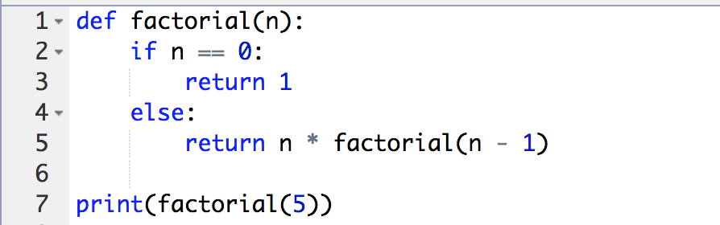
Recursive Function

Slide 49
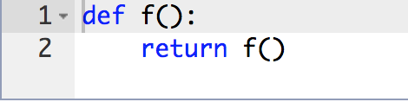
Recursive Function

Slide 50
Recursive Function
Recursive functions are powerful mechanism in programming.
Unfortunately, they are not always effective and often lead to mistakes.
The most common error is infinite recursion, when the chain of function calls never ends (well, actually, it ends when you run out of free memory in your computer).

Slide 51
Reminder, rules so far
Think before you program!
A program is a human-readable essay on problem solving that also happens to execute on a computer.
The best way to improve your programming and problem solving skills is to practice!
A foolish consistency is the hobgoblin of little minds (pay attention to the naming)
Test your code, often and thoroughly
If it was hard to write, it is probably hard to read. Add a comment.
All input is evil, unless proven otherwise.
A function should do one thing.

Slide 52
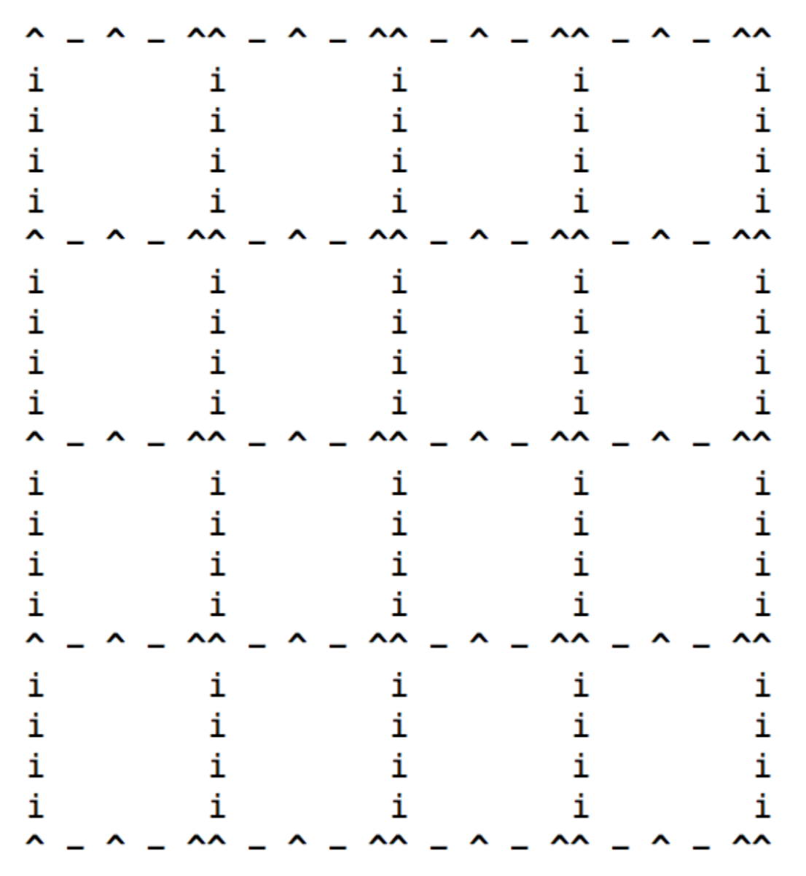
Practice Question: get the following output without using the loops.

